Slide 1


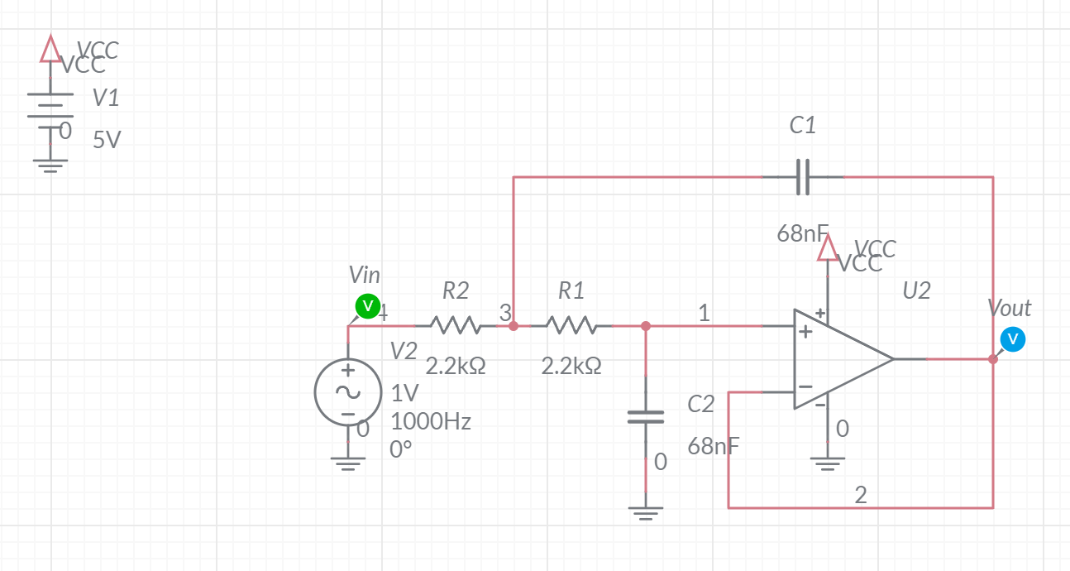
Sallen-Key Filter Design and Analysis
Objective:
The objective of this lab is to study the design, simulation and construction of the filters on the audio board and measure their performance.
1

Slide 2
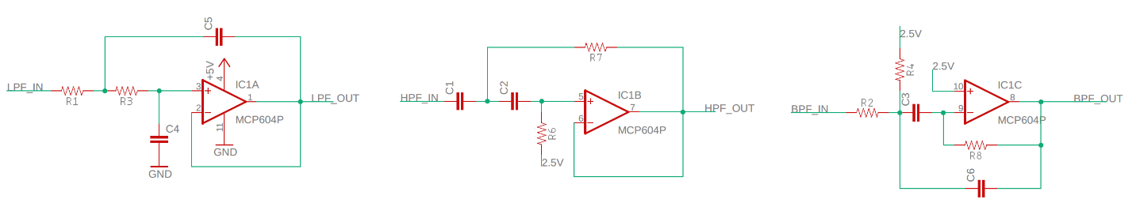
Filters
Audio Board has 3 filters
LPF and HPF are Sallen Key architecture
BPF is hybrid
2
2
Notes:
2

Slide 3
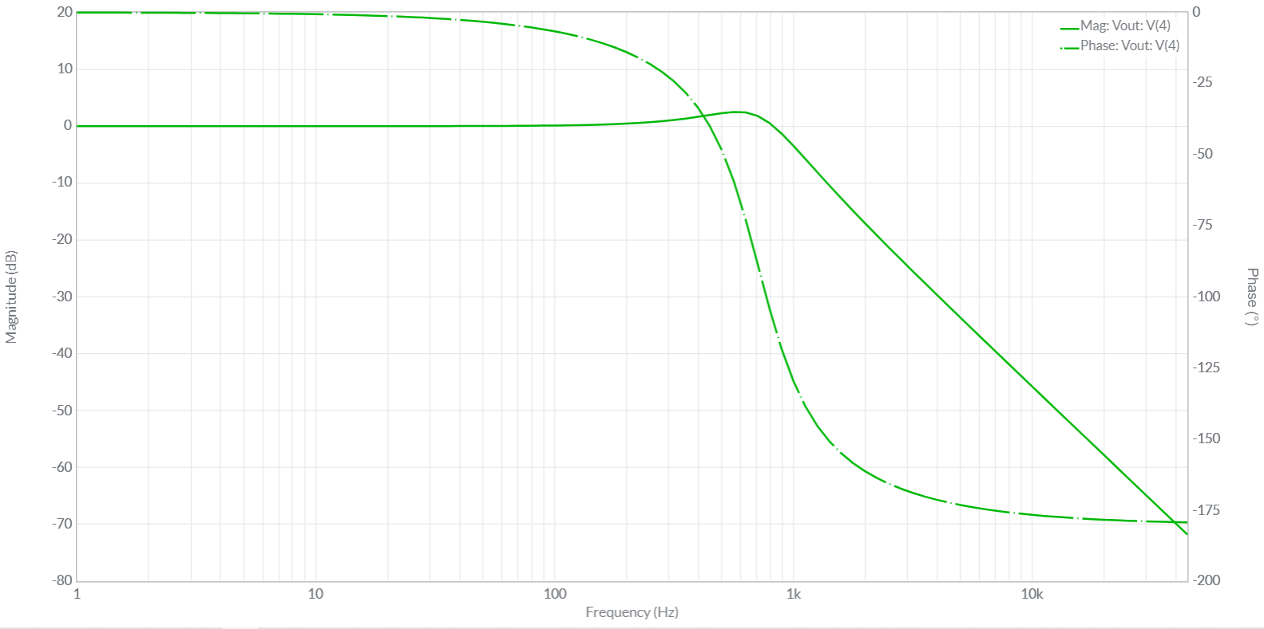
Bode Plot
Sine wave input produces sine wave output
Frequency is preserved
Amplitude and Phase change
3
3
Notes:
3

Slide 4
How To’s in today’s lab
Use the Analog Devices Wizard
Simulation: MultiSim Live Time Domain
Simulation: MultiSim Live Frequency Sweep
Circuit: Time Domain
Circuit: Frequency Response Analysis
4
4
Notes:
4

Slide 5
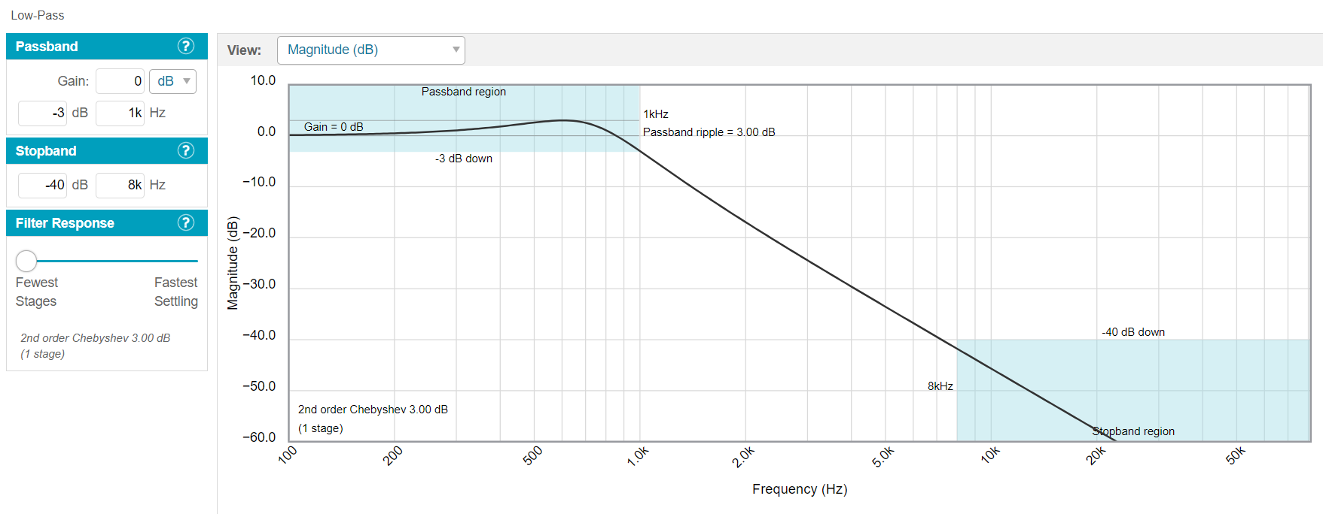
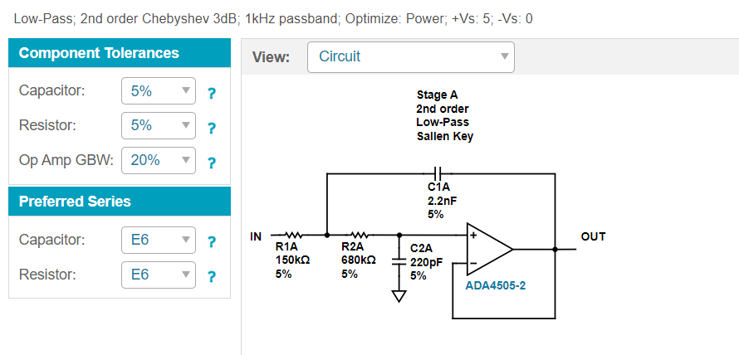
Analog Device Wizard
Specify filter performance
Get filter topology and component values
5
5
Notes:
5

Slide 6
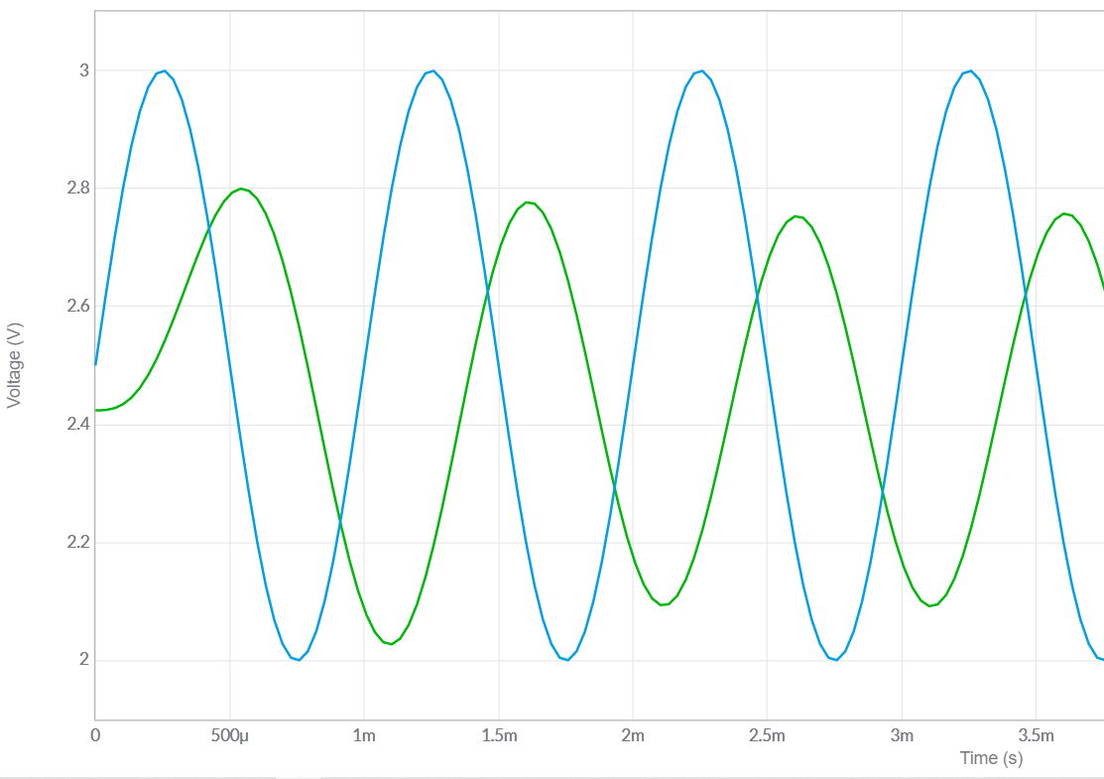
Simulation: Point-by-Point
Build model in MultiSim Live
Apply sin wave at some frequency
Measure change in amplitude in dB
Measure change in phase in degrees
Plot dB and phase as a function of frequency
6
6
Notes:
6

Slide 7
Circuit: Point-by-Point
Solder in parts to Audio board
Apply sin wave at some frequency
Measure change in amplitude in dB
Measure change in phase in degrees
Plot dB and phase as a function of frequency
7
7
Notes:
7

Slide 8
Listen to effect of filters
Jumper filters into audio path
AUDIO_IN to
filter INPUT
filter OUTPUT to
AMP_IN
8
8
Notes:
8

